Slide 1

Machine Learning
ICT-4261
By-
Dr. Jesmin Akhter
Professor
Institute of Information Technology
Jahangirnagar University

Slide 2
Contents
The course will mainly cover the following topics:
A Gentle Introduction to Machine Learning
Logistic Regression
Naive Bayes
Support Vector Machines
Decision Trees and Ensemble Learning
Clustering Fundamentals
Hierarchical Clustering
Neural Networks and Deep Learning
Unsupervised Learning

Slide 3
Outline
Naive Bayes
Bayes' theorem

Slide 4


Bayes' theorem
What is conditional probability?
A conditional probability is usually defined as the probability of one event given the occurrence of another event.
If A and B are two events, then the conditional probability me be designated as P(A given B) or P(A|B).
Bayes’s theorem is used for the calculation of a conditional probability where intuition often fails.
Let's consider two probabilistic events A and B. We can correlate the marginal probabilities P(A) and P(B) with the conditional probabilities P(A|B) and P(B|A) using the product rule:

Slide 5
Bayes' theorem
Bayes’ Theorem finds the probability of an event occurring given the probability of another event that has already occurred. Bayes’ theorem is stated mathematically as the following equation:
where A and B are two probabilistic events and P(B) ≠ 0.
Basically, we are trying to find probability of event A, given the event B is true. Event B is also termed as evidence.
P(A) is the priori of A (the prior probability, i.e. Probability of event before evidence is seen). The evidence is an attribute value of an unknown instance(here, it is event B).
P(A|B) is a posteriori probability of B, i.e. probability of event after evidence is seen.
Notes:
Bayes theorem is also known with some other name such as Bayes rule or Bayes Law. Bayes theorem helps to determine the probability of an event with random knowledge. It is used to calculate the probability of occurring one event while other one already occurred. It is a best method to relate the condition probability and marginal probability.

Slide 6
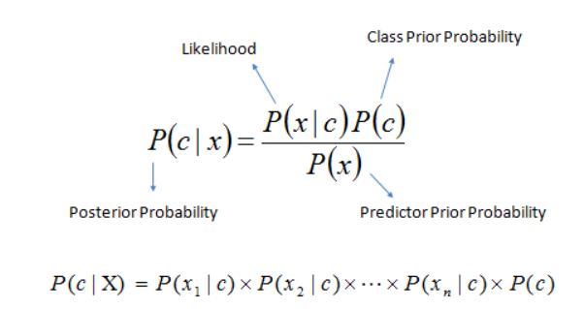
Bayes' theorem
The Naive Bayesian classifier is based on Bayes’ theorem with the independence assumptions between predictors. In simple terms, a Naive Bayes classifier assumes that the presence of a particular feature in a class is unrelated to the presence of any other feature.
A Naive Bayesian model is easy to build, with no complicated iterative parameter estimation which makes it particularly useful for very large datasets. Despite its simplicity, the Naive Bayesian classifier often does surprisingly well and is widely used because it often outperforms more sophisticated classification methods.
Algorithm
Bayes theorem provides a way of calculating the posterior probability, P(c|x), from P(c), P(x), and P(x|c). Naive Bayes classifier assume that the effect of the value of a predictor (x) on a given class (c) is independent of the values of other predictors. This assumption is called class conditional independence.
P(c|x) is the posterior probability of class (target) given predictor (attribute).
P(c) is the prior probability of class.
P(x|c) is the likelihood which is the probability of predictor given class.
P(x) is the prior probability of predictor.
In ZeroR model there is no predictor, in OneR model we try to find the single best predictor, naive Bayesian includes all predictors using Bayes' rule and the independence assumptions between predictors.

Slide 7


Bayes' theorem-Problem 1
Imagine we want to implement a very simple spam filter and we've collected 100 emails. We know that 30 are spam and 70 are regular. So we can say that P(Spam) = 0.3.
However, we'd like to evaluate using some criteria, for example, email text is shorter than 50 characters. Therefore, our query becomes:
The first term is similar to P(Spam) because it's the probability of spam given a certain condition. For this reason, it's called a posteriori (in other words, it's a probability that we can estimate after knowing some additional elements). On the right-hand side, we need to calculate the missing values,
Let's suppose that 35 emails have text shorter than 50 characters, so P(Text < 50 chars) = 0.35. Looking only into our spam folder, we discover that only 25 spam emails have short text, so that P(Text < 50 chars|Spam) = 25/30 = 0.83. The result is:
So, after receiving a very short email, there is a 71% probability that it's spam.

Slide 8
Problem 2
Assume that the word ‘offer’ occurs in 80% of the spam messages in your account. Also, let’s assume ‘offer’ occurs in 10% of your desired e-mails. If 30% of the received e-mails are considered as a scam, and you will receive a new message which contains ‘offer’, what is the probability that it is spam?
Explanation without Bayes’ Equation
Assume total 100 e-mails.
The percentage of spam in the whole e-mail is 30%.
So, 30 spam e-mails and 70 desired e-mails in 100 e-mails.
The percentage of the word ‘offer’ that occurs in spam e-mails is 80%.
It means 80% of 30 spam e-mail and it makes 24 spam email contain the word offer where 6 of them does not contain ‘offer’.
The percentage of the word ‘offer’ that occurs in the desired e-mails is 10%.
It means 7 of them (10% of 70 desired e-mails) contain the word ‘offer’ and 63 of them not.
Now, we can see this logic in a simple chart.

Slide 9
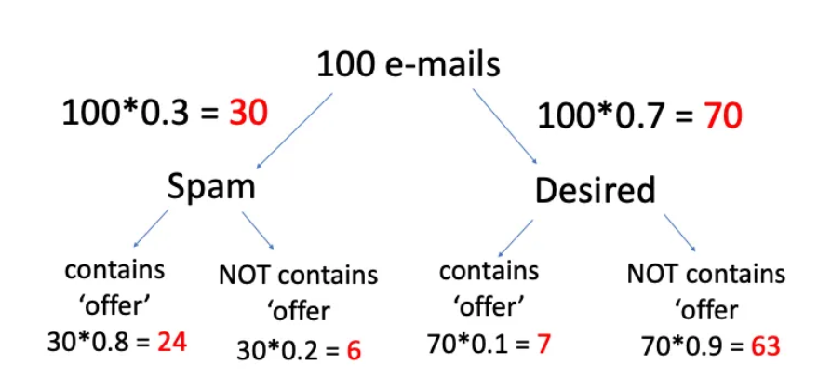
The question was what is the probability of spam where the mail contains the word ‘offer’:
We need to find the total number of mails which contains ‘offer’ ;
24 +7 = 31 mail contain the word ‘offer’
2. Find the probability of spam if the mail contains ‘offer’ ;
In 31 mails 24 contains ‘offer’ means 77.4% = 0.774 (probability)

Slide 10
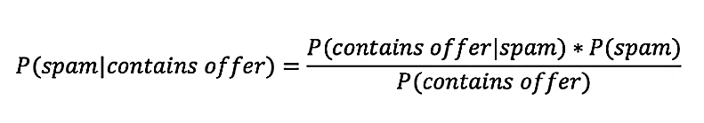

Solution with Bayes’ Equation
A = Spam
B = Contains the word ‘offer’
P( contains offer|spam) = 0.8 (given in the question)
P(spam) = 0.3 (given in the question)
Now we will find the probability of e-mail with the word ‘offer’. We can compute that by adding ‘offer’ in spam and desired e-mails. Such that;
P(contains offer) = 0.3*0.8 + 0.7*0.1 = 0.31

Slide 11
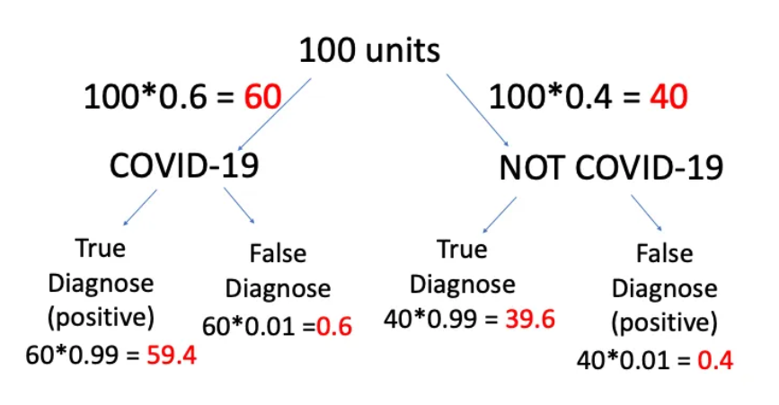
Problem 3
As you know, Covid-19 tests are common nowadays, but some results of tests are not true. Let’s assume; a diagnostic test has 99% accuracy and 60% of all people have Covid-19. If a patient tests positive, what is the probability that they actually have the disease?

Slide 12
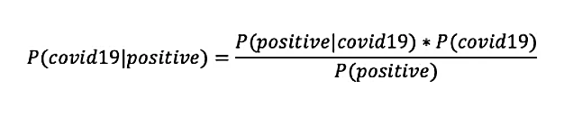
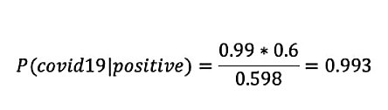
Solution with Bayes’ Equation
The total units which have positive results= 59.4 + 0.4 = 59.8
59.4 units (true positive) is 59.8 units means 99.3% = 0.993 probability
With Bayes’;
P(positive|covid19) = 0.99
P(covid19) = 0.6
P(positive) = 0.6*0.99+0.4*0.01=0.598

Slide 13
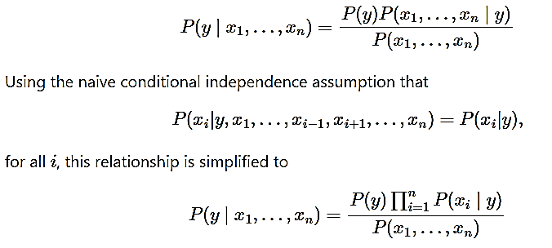
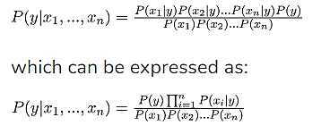
Naive Bayes
Naive Bayes methods are a set of supervised learning algorithms based on applying Bayes’ theorem with the “naive” assumption of conditional independence between every pair of features given the value of the class variable. Bayes’ theorem states the following relationship, given class variable y and feature vector x₁ through x_{n}

Slide 14
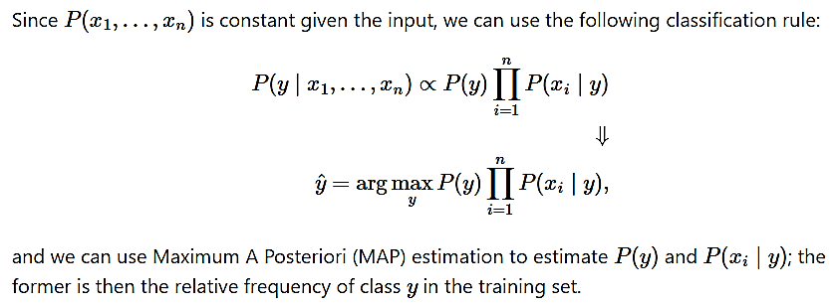
Naive Bayes
Now, we need to create a classifier model. For this, we find the probability of given set of inputs for all possible values of the class variable y and pick up the output with maximum probability. This can be expressed mathematically as:
Please note that P(y) is also called class probability and P(x_{i} | y) is called conditional probability

Slide 15
Why is it called Naïve Bayes?
The Naïve Bayes algorithm is comprised of two words Naïve and Bayes, Which can be described as: Naïve: It is called Naïve because it assumes that the occurrence of a certain feature is independent of the occurrence of other features. Such as if the fruit is identified on the bases of color, shape, and taste, then red, spherical, and sweet fruit is recognized as an apple. Hence each feature individually contributes to identify that it is an apple without depending on each other.
Bayes: It is called Bayes because it depends on the principle of Bayes' Theorem.

Slide 16
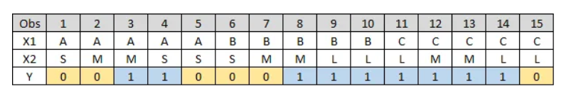
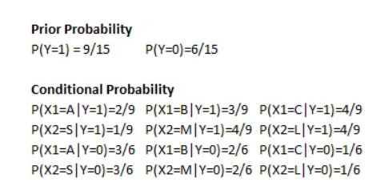
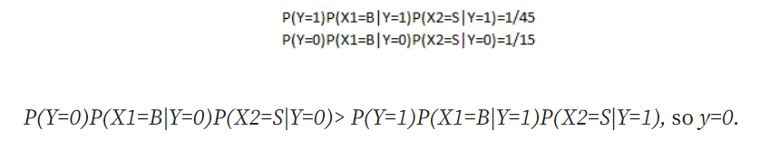
Estimate Prior and Conditional probability
Use formula above to estimate prior and conditional probability, and we can get:

Slide 17
Tabular representation of an example dataset
 | Outlook | Temperature | Humidity | Windy | Play Golf
0 | Rainy | Hot | High | False | No
1 | Rainy | Hot | High | True | No
2 | Overcast | Hot | High | False | Yes
3 | Sunny | Mild | High | False | Yes
4 | Sunny | Cool | Normal | False | Yes
5 | Sunny | Cool | Normal | True | No
6 | Overcast | Cool | Normal | True | Yes
7 | Rainy | Mild | High | False | No
8 | Rainy | Cool | Normal | False | Yes
9 | Sunny | Mild | Normal | False | Yes
10 | Rainy | Mild | Normal | True | Yes
11 | Overcast | Mild | High | True | Yes
12 | Overcast | Hot | Normal | False | Yes
13 | Sunny | Mild | High | True | No
The dataset is divided into two parts, namely, feature matrix and the response vector.
Feature matrix contains all the vectors(rows) of dataset in which each vector consists of the value of dependent features. In the dataset, features are ‘Outlook’, ‘Temperature’, ‘Humidity’ and ‘Windy’.
Response vector contains the value of class variable(prediction or output) for each row of feature matrix. In the dataset, the class variable name is ‘Play golf’

Slide 18
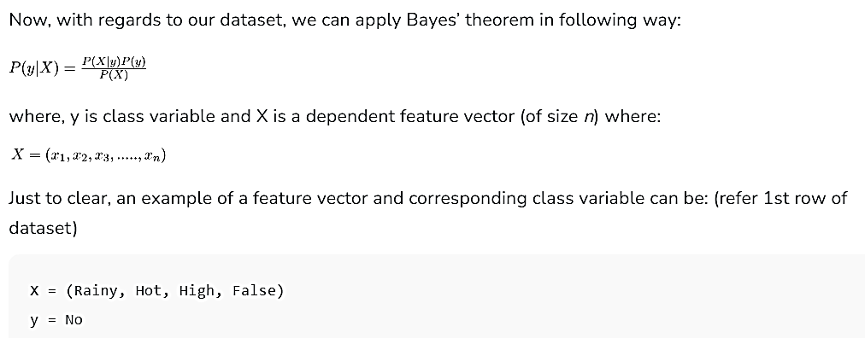
With relation to our dataset, this concept can be understood as:
We assume that no pair of features are dependent. For example, the temperature being ‘Hot’ has nothing to do with the humidity or the outlook being ‘Rainy’ has no effect on the winds. Hence, the features are assumed to be independent.
Secondly, each feature is given the same weight(or importance). For example, knowing only temperature and humidity alone can’t predict the outcome accurately. None of the attributes is irrelevant and assumed to be contributing equally to the outcome.

Slide 19
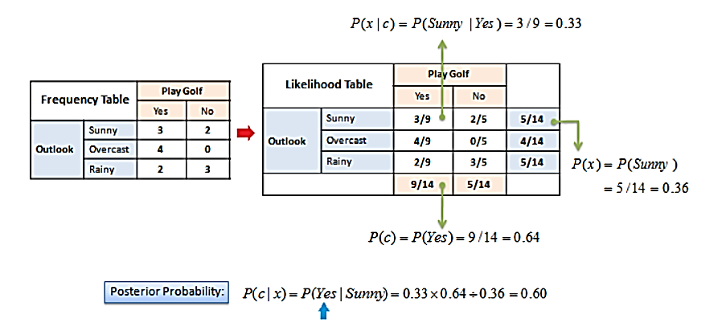
Naive assumption Example 1
The posterior probability can be calculated by first, constructing a frequency table for each attribute against the target. Then, transforming the frequency tables to likelihood tables and finally use the Naive Bayesian equation to calculate the posterior probability for each class. The class with the highest posterior probability is the outcome of prediction.

Slide 20
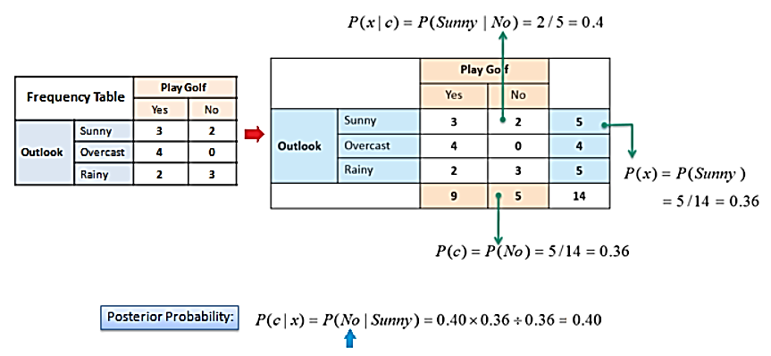
Naive assumption

Slide 21
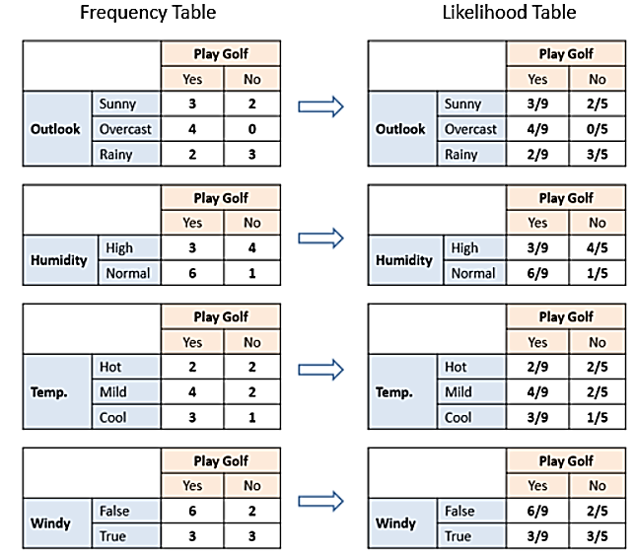
Naive assumption
The likelihood tables for all four predictors.

Slide 22
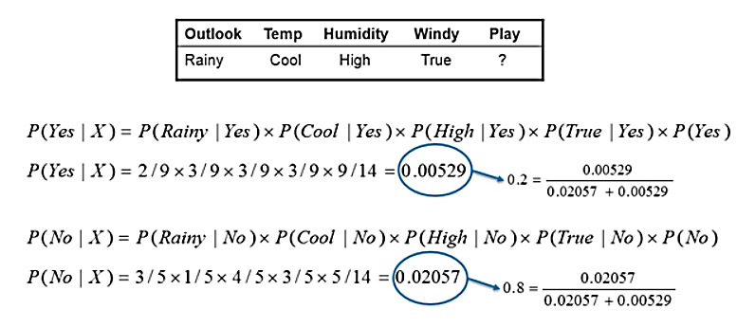
Naive assumption Example 2
In this example we have 4 inputs (predictors). The final posterior probabilities can be standardized between 0 and 1.

Slide 23
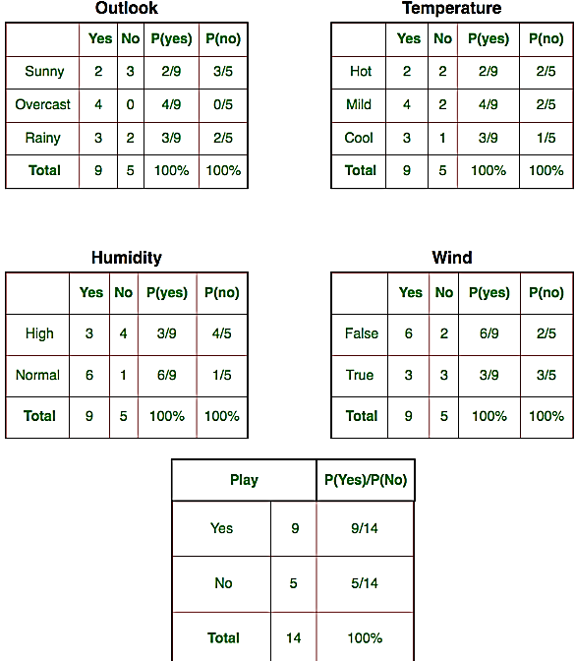
Naive assumption Example 3
Let us try to apply the Naive formula manually on our weather dataset.
We need to find P(x_{i} | y_{j}) for each x_{i} in X and y_{j} in y.
So, in the figure, we have calculated P(x_{i} | y_{j}) for each x_{i} in X and y_{j} in y manually in the tables 1-4. For example, probability of playing golf given that the temperature is cool, i.e P(temp. = cool | play golf = Yes) = 3/9.
Also, we need to find class probabilities (P(y)) which has been calculated in the table 5. For example, P(play golf = Yes) = 9/14.

Slide 24
Naive assumption
So now, we are done with our pre-computations and the classifier is ready!
Let us test it on a new set of features (let us call it today):
today = (Sunny, Hot, Normal, False)
So, probability of playing golf is given by:
and probability to not play golf is given by:

Slide 25
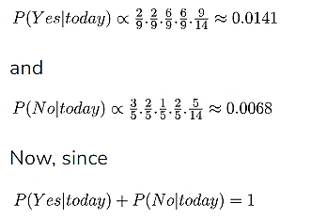
Naive assumption
Since, P(today) is common in both probabilities, we can ignore P(today) and find proportional probabilities as:

Slide 26
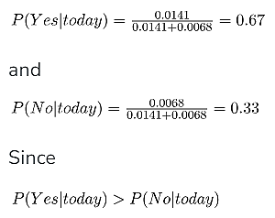
Naive assumption
These numbers can be converted into a probability by making the sum equal to 1 (normalization):
So, prediction that golf would be played is ‘Yes’.
The method that we discussed above is applicable for discrete data. In case of continuous data, we need to make some assumptions regarding the distribution of values of each feature. The different naive Bayes classifiers differ mainly by the assumptions they make regarding the distribution of P(x_{i} | y).

Slide 27
Thank You

